Slide 1
LAW OF DEMAND

Slide 2
Objective:
To be able to explain the concept of law of demand
Learning Outcomes:
Define demand
Describe individual demand and market demand
Explain Law of demand
EXTENSION – Plot the demand curve

Slide 3
Demand is willingness and ability to purchase a good or service at any given price.
Objective:
To be able to explain the concept of law of demand
Outcome:
Define demand
Describe individual demand and market demand
Explain Law of demand
Extension – Plot the demand curve

Slide 4
INDIVIDUAL AND MARKET DEMAND
Objective:
To be able to explain the concept of law of demand
Outcome:
Define demand
Describe individual demand and market demand
Explain Law of demand
Extension – Plot the demand curve
Individual demand is the demand of just one customer while market demand for a product is the total demand for that product from all its consumers

Slide 5
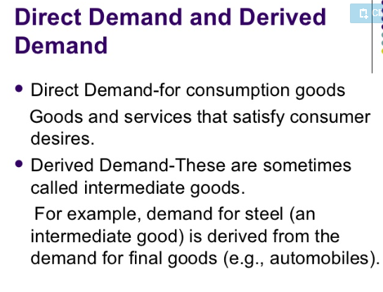
Individual demand and Market Demand
Objective:
To be able to explain the concept of law of demand
Outcome:
Define demand
Describe individual demand and market demand
Explain Law of demand
Extension – Plot the demand curve
Individual demand is the demand of just one customer while market demand for a product is the total demand for that product from all its consumers

Slide 6
https://www.youtube.com/watch?v=QvGLcCTXk9o

Slide 7
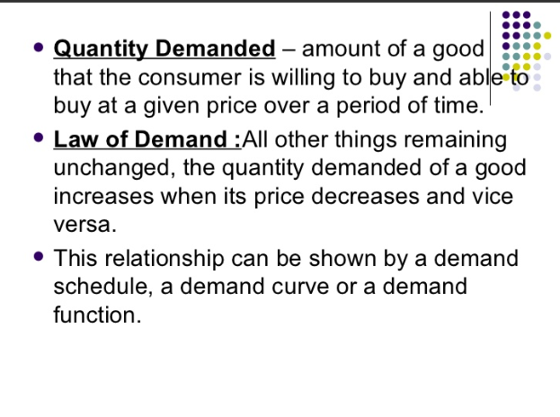
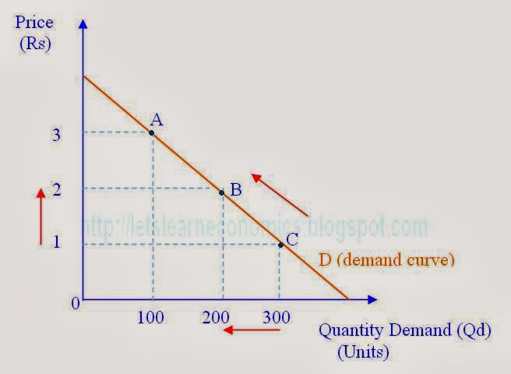
Law of Demand – ceteris paribus, if price of a good or a service increases, quantity demanded decreases and vice versa. There is a inverse relationship between price and quantity demanded.
Objective:
To be able to explain the concept of law of demand
Outcome:
Define Law of demand
Explain concept of Contraction & Extension in Demand
Plot the demand curve

Slide 8
ACTIVITY 2.9 – Page number 41

Slide 9
EXTENSION AND CONTRACTION OF DEMAND
Objective:
To be able to explain the concept of law of demand
Outcome:
Define Law of demand
Explain concept of Contraction & Extension in Demand
Plot the demand curve
Contraction in demand - Ceteris Paribus, When price increases quantity demanded decreases. There is a upward movement along demand curve.
Extension in demand- Ceteris Paribus, When price decreases quantity demanded increases. There is a downward movement along demand curve.

Slide 10
Lesson Objective:
To be able to explain reasons for shifts in demand curve
Lesson Outcome:
Explain the reasons for shifts in demand curve
Illustrate increase and decrease in demand
Differentiate between increase in demand and extension in qty demanded & decrease in demand and contraction in quantity demanded

Slide 11
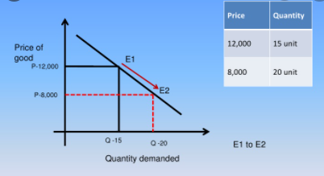
RECAP
Identify the movement along the demand curve in the diagram

Slide 12
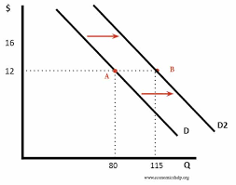
Increase in Demand
Increase in demand means that consumers now demand more of a product at each and every price than they did before and demand curve will shift to the right.
https://youtu.be/Enz6z9jGmsk
Price
Price

Slide 13
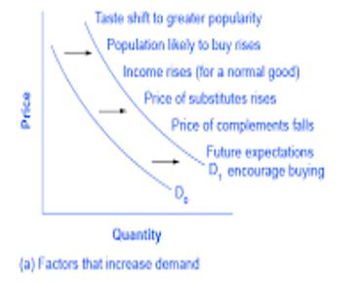
Factors causing increase in demand
Decrease in income taxes
Positive advertising
Seasonal changes

Slide 14
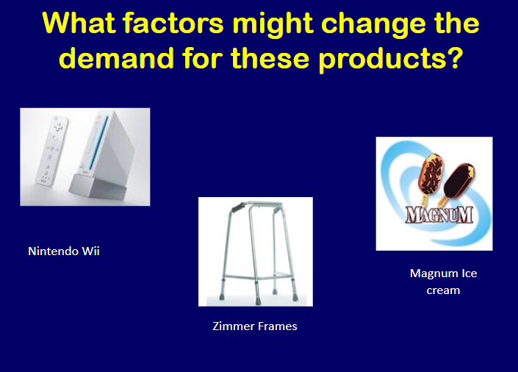

Slide 15
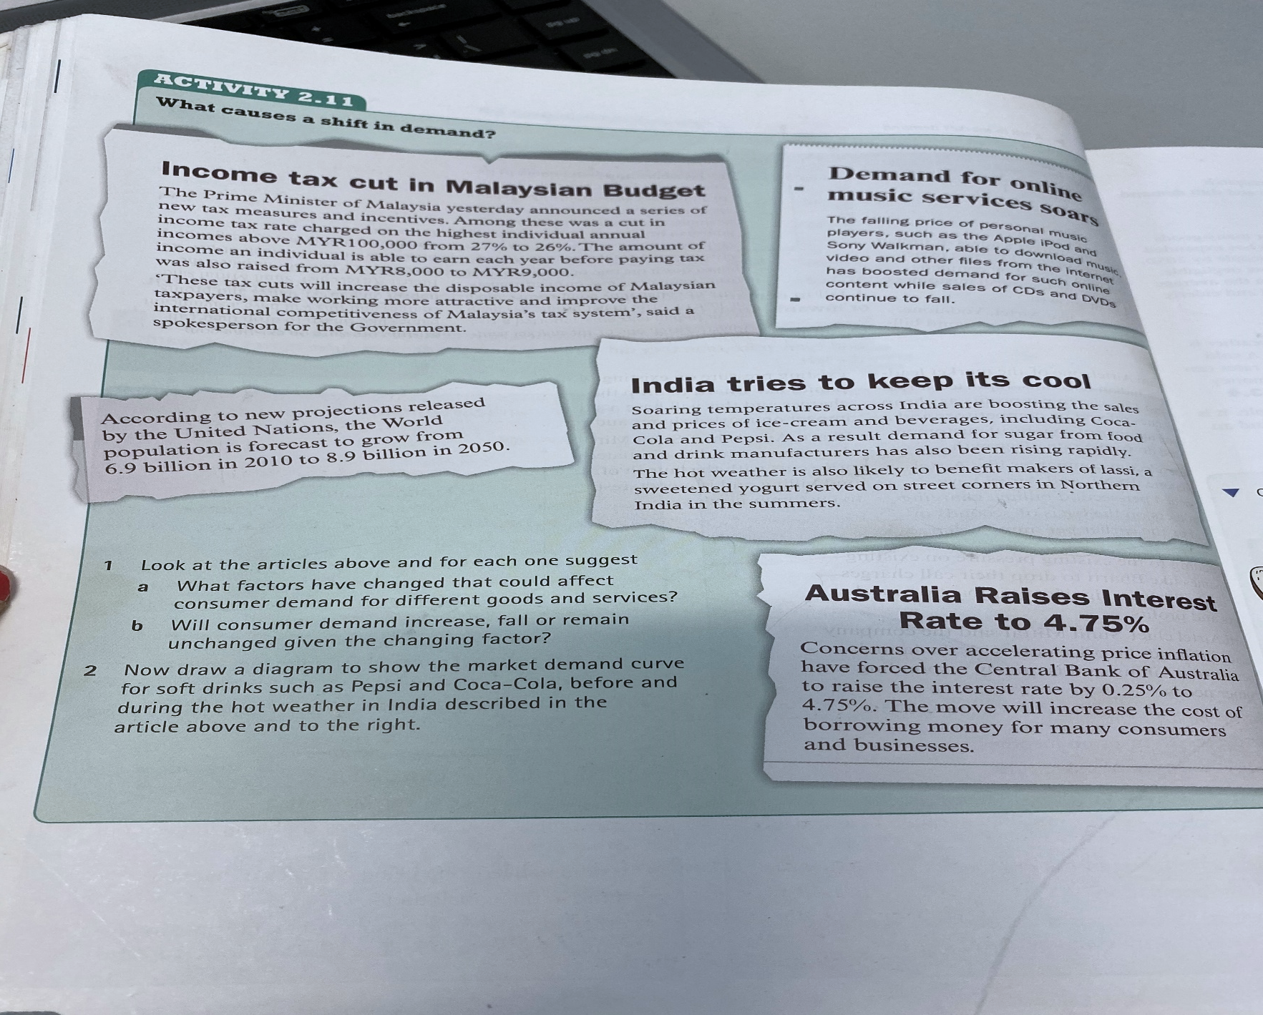
Activity 2.11 in the text book on page 46

Slide 16
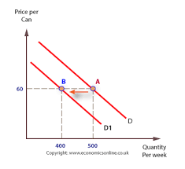
Decrease in Demand
Decrease in demand means that consumers now demand less of a product at each and every price than they did before and demand curve will shift to the left.
Identify factors causing decrease in demand.

Slide 17
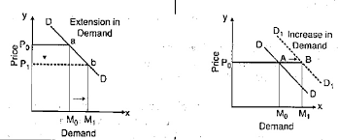
Difference between increase in demand and increase in qty demanded/extension in demand
Decrease in price will lead to increase in qty demanded or extension in demand.
Change in non price factors will lead to an increase in demand and shift in demand curve
to the right – example increase in income levels.

Slide 18
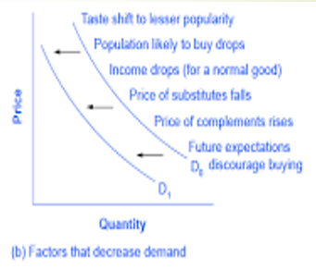
Factors that decrease demand

Slide 19
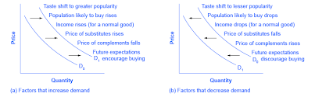
Summary of factors causing shifts in demand curve

Slide 20
Lesson Objective:
To be able to explain reasons for shifts in demand curve
Lesson Outcome:
Explain the reasons for shifts in demand curve
Illustrate increase and decrease in demand
Differentiate between increase in demand and extension in qty demanded & decrease in demand and contraction in quantity demanded

Slide 21
Explain, using a diagram the difference between decrease in demand and decrease in qty demanded?

Slide 22
TASK
Solve the worksheets provided in class handouts on one note.
Worksheets to be solved below the word document and not on the document itself.

